Slide 1
Fast Start 2018 Optimizing Resources, Scheduling, and Deployment With Decision Optimization for DSX Local João (John) Chaves Analytics Solutions Architect

Slide 2
Learning Objectives
By the end of this session, you should be able to …
Understand Prescriptive Analytics
Articulate the structure of Decision Optimization for Data Science (DODS)
Understand the different options for running DO in DSX Local
Build simple solutions using DO in DSX Local

Slide 3
Agenda
IBM Optimization Solutions
What is Optimization
Where can it be applied
Optimization vs. Machine Learning
DODS - Decision Optimization for Data Science (Add-On to DSX Local)
Hands-on exercises:
Utilizing the DOCplex Python API from Notebooks
Creating an Optimization Model & Planning scenarios with DODS
Preview Execution Service (coming soon)

Slide 4
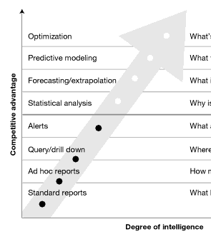
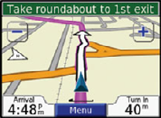

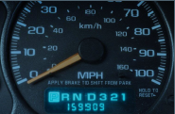
Prescriptive Analytics (aka Optimization) is about…
Making the best decision possible given objective and constraints.
Manage resource efficiency, utilization and allocation
Decide, choose, plan, schedule, assign, route, source, maintain, locate, trade-off
Prescriptive
Prescriptive
Action Plan
Predictive
Forecasts
Business
Intelligence
Describe the
situation

Slide 5


Why Optimization? - Number of choices
A single truck visiting 5 different locations
120 different routes
A single truck visiting 10 different locations
Over 3 million routes
A single truck visiting 21 different locations
There are more possibilities that the grains of sands in the world!
Notes:
Let’s say you have a single truck that needs to visit 5 different locations and we are trying to determine in what order to visit these locations in order to minimize the distance traveled. The number of different ways in which we can visit these 5 locations is 120. So we can easily enumerate them, sort them and pick the best. If we double the number of locations that we need to visit to 10 then the number of possibilities goes from 120 to over 3 million. So by increasing the inputs by a factor of 2 we increase the possibilities that we need to consider by a factor of 20,000!
Consider now that real world problems contain 100s of trucks and 1000s of locations, the number of possibilities that we have to consider is literally larger than the number of grains of sand in the entire world. It is impossible to look for this proverbial needle or grain in a hay stack even if we had a lifetime to do it. Yet companies like UPS and FedEx solve this problem repeatedly on a daily basis.
This problem is known as the combinatorial explosion, in which the number of combinations that we need to consider grows much faster than what we can keep up with.
20! = 2.43E+18
21! = 5.11E+19
Number of grains of sand on earth: 7.5E+18
https://www.npr.org/sections/krulwich/2012/09/17/161096233/which-is-greater-the-number-of-sand-grains-on-earth-or-stars-in-the-sky

Slide 6
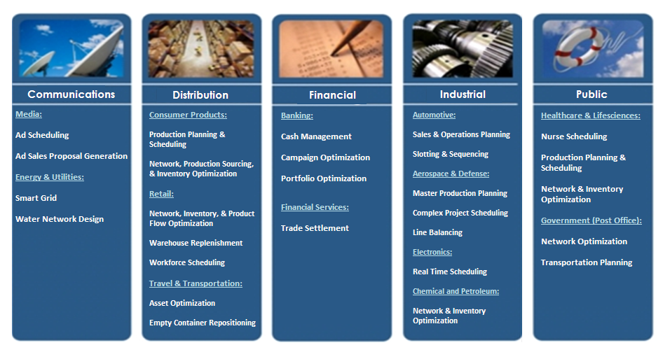
Industry Use Cases

Slide 7
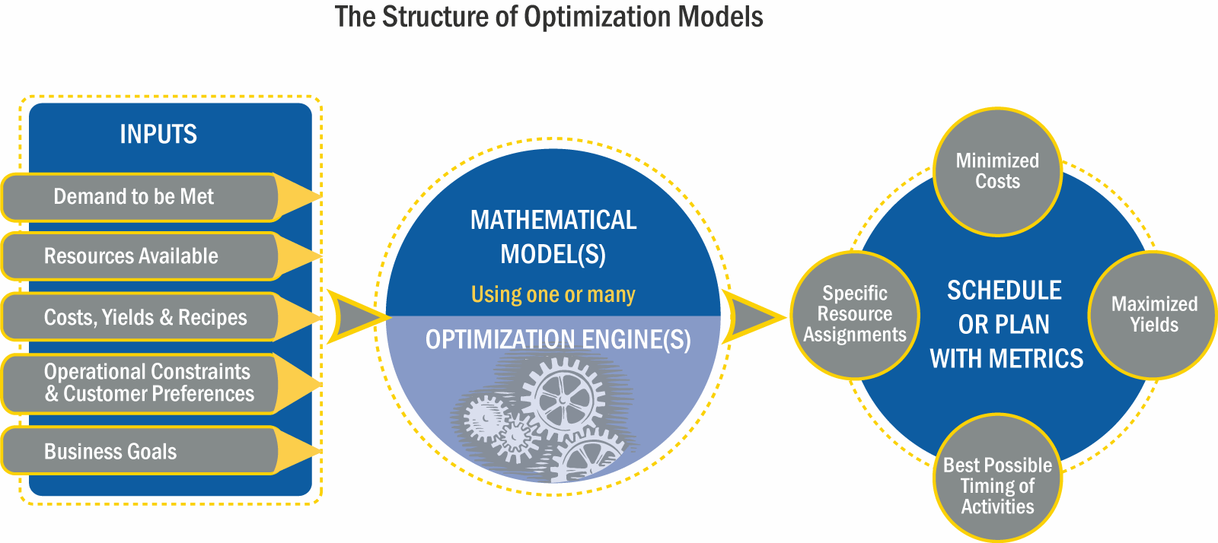
Prescriptive Analytics – How Does It Work?
Output is typically written back to an ERP or a DB and can be consumed through a BI solution
In many cases ”Demand to be Met” comes from a Predictive Analytics Solution like SPSS
The model is typically created by a “quant” and is specific to the business problem and industry
3
5
2
Inputs typically come from ERP systems, siloed DBs or entered manually
The engine is the run-time component of the IBM Decision Optimization software
1
4
Notes:
Fundamentally the prescriptive analytics / optimization technology and our IBM Decision Optimization products work very similarly to all other analytics technologies and tools.
At first, they need to consume various sets of data that are typically available in ERPs or DBs of one or more departments across the enterprise. It is also common for specific inputs to be manual. In most cases the inputs have to do with the resources that are available and have to be managed, the demand that needs to be satisfied by these resources, additional costs of using resources, and rules of when each resource can be applied or other capacities. Finally, there are business goals that users are typically interested in and define what makes one solution better than another. For example total cost, or revenue or service level to name a few.
Out of all of these in most cases the demand piece might come from a predictive analytics solution like SPSS. However, in organizations that have not implemented any predictive analytics solution this input could simply come from individual estimates or historical averages or a combination of both.
The third step is critical and common to all analytics. An expert has to build a model that consumes the inputs. This model is simply a representation of what can and cannot happen in the business world. Just like a data scientists or statistician builds an SPSS stream an Operations Research professional or Industrial Engineer typically builds an optimization model. Several modeling examples and tutorials are available with the IBM Decision Optimization product distributions. Certain products also contain a modeling environment that make the construction and debugging of models simple.
Once the model is built we load it with the input data to create a problem instance and pass that to the optimization engine. The engine is at that heart our IBM Decision Optimization products. It uses advanced algebraic procedures to determine the best, according to the goals, alternative out of millions if not billions of possibilities in a short amount of time. When finished the engine returns the choices that will result in the maximization or minimization of the selected goals.
The engine choices are typically written back to an ERP system or a DB or can be reviewed through a business intelligence solution like IBM Cognos.
Ideally this process is streamlined and in control of the business user who reviews the result of one solution, changes one of the inputs to create a "what-if” scenario, solves that scenario and compares the two solutions. Once the user is satisfied with one of the solutions they can submit it to their official execution system.

Slide 8
What Is an Optimization Model?
A translation of your business problem into math
Business goals / KPIs
Increase profits
Model objectives
Maximize Profit
Levers / decisions affecting goals
How much product A should we produce?
Model variables
Production_ProductA
Business “rules” constraining decisions
Production must be less than plant capacity
Model constraints
Production_ProductA ≤ Capacity_A
Describe key parameters of the problem, not how to solve it!
Notes:
In all optimization models there are three key constructs that are necessary for the optimization engine to return a solution.
1) The Business Goals (in business terms) or Objectives (in math). An example of an objective (or business goal) is “Maximize Profit”. These are typically the key performance indicators that the business is trying to improve (either increase or decrease). It is common for real world business problems to have multiple Business Goals and as a result the corresponding optimization models will have multiple objectives. For example a company might be looking to maximize profits and minimize cost and maximize service level to customers.
2) The Decisions (in business terms) or Variables (in math). These are the assignments/schedules/plans/routes/allocations that the business is struggling to decide on. An example of a Decision is “how much product A to produce?” (typically in a certain location and a certain time period). In the mathematical model this will be represented by a specific variable, say “X”, or “Production_ProductA” or something equivalent. In a typical optimization model you would have hundreds of thousands and sometimes millions of variables. Typically the more variables you take into consideration the more detailed and valuable your model and solution becomes.
3) The Business Rules (in business terms) or Constraints (in math). These are the rules or constraints that the decisions need to respect. For example “production must be less than the plan capacity”. This would correspond to a constraint in the optimization model that says “Production_ProductA <= Capacity”. In a typical optimization model you can have dozens of different constraints types, like respect a capacity, respect a product flow connection from location to location, respect precedence constraints between tasks, etc.

Slide 9
Machine Learning vs Optimization 101
Machine Learning:
Key Metric:
Model Performance
When is it better:
Higher performance, better accuracy
Business impact:
We can predict future events, score and classify customers/pictures/text/audio more accurately and act on that.
Optimization:
Key Metric:
Objective Function Value
When is it better:
Get close to optimality
Business impact:
Lower cost or higher revenue which improves bottom line

Slide 10
Machine Learning vs Optimization 101
Machine Learning 101
Basic (supervised): you know the answer and you train the machine how to find it
More advanced – unsupervised, reinforcement, & deep learning
Optimization 101
You don’t know the answer, and you teach the machine the logic to find it
More advanced – robust/stochastic/…
Unknowns
(decision variables)
Train ML model
Sample data
Prediction
(optional)
Solve Opti model
Decisions, plans, schedules
Solve trained model
Prediction, pattern, classification
Business goals
Observations
Business constraints
Notes:
Learning 101
Basic (supervised): you know the answer and you teach the machine how to find it
More advanced
Unsupervised learning: machine discovers patterns
Reinforcement learning: awards indicate success – think self-driving cars
Deep learning: pattern/image/object/speech recognition, text processing, time series analysis
Optimization 101
You don’t know the answer, and you teach the machine the logic to find it
Capture business goals, decision variables, and constraints
More advanced – robust/stochastic
Parallels between machine learning & decision optimization
Complexity
Both involve complex mathematics and algorithms
Both require experts to effectively build & deploy solutions
Both involve exponential network growth (e.g. MIP trees, deep nets), and often weights & probabilities (e.g. stochastic)
Proven – both have been around for decades
Data
Results depend on the quality of data
Require analysis to verify the accuracy of results (training vs post-optimization analysis)

Slide 11

Children of the Corn (1984)
In a small town in Iowa, possessed children are on a mission to kill adults.
…and lab instructors?

Slide 12


Slide 13
Prescriptive Analytics Ties in to All Machine Learning Use Cases
Machine Learning:
Customer Scoring / Classification
Preventive Maintenance
Insurance Claim Prediction/Prevention
Demand Forecast
Retail: SKUs / Channels
CPG / Manufacturing: SKUs
Finance: Market direction
Energy & Utilities: Energy
Optimization:
Campaign Assignment
Scheduling Technicians
Insurance Agent Scheduling
Resource Scheduling / Assignment
Retail: Supplier Orders / Inventory
CPG / Manufacturing: Production Orders
Finance: Portfolio Management
Energy & Utilities: Demand Response

Slide 14

DISCLAIMER
THE DECISION OPTIMIZATION FOR DATA SCIENCE (DODS) ADD-ON TO DSX IS - AS OF JANUARY 29TH 2018 - STILL IN BETA, WITH RELEASE SCHEDULED FOR THE END OF Q1, 2018.
THE FEATURES PRESENTED HERE AND ON THE LAB EXERCISES MAY CHANGE UNTIL THE PRODUCT’S FINAL RELEASE.

Slide 15

DODS is an Add-on to DSX Local
Data Scientist - Browser
Data Stores (DB2, HDFS, etc…)
LDAP/AD
Spark Cluster
Customer Systems
DSX Local Cluster
NGINX
DSX UI Service
Compute Servers
Control Servers
Storage Servers
Admin Dashboards
Redis
Kubernetes Cluster
Metering Monitoring
Gluster
Zeppelin Notebook Service
Jupyter Notebook Service
Spark Service
RStudio Service
Project Service
Kubernetes Master Components
Cloudant
Storage
Canvas & Models
Analytic
libraries
DODS
Docplex
DODS

Slide 16
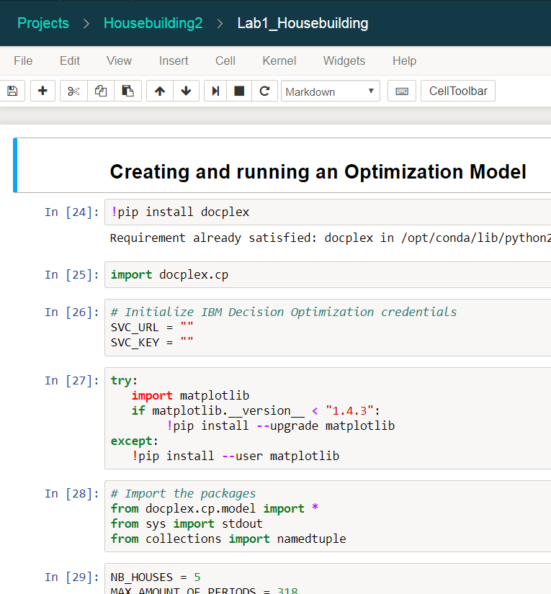
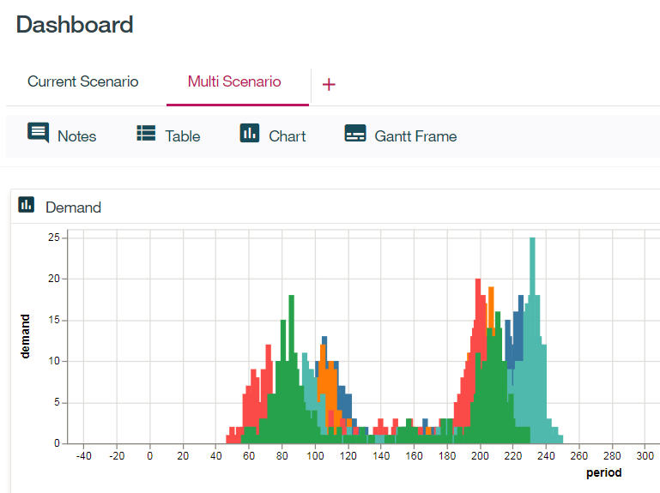
Three Ways to Run Optimization in DSX Local
DOCplex Python API on Jupyter Notebooks
Local
On Cloud
Using the DODS Add-on (BETA)
Framework API from a Notebook (require DODS) (BETA)
Using the Remote Execution service (BETA)

Slide 17




Using the DOCplex Python API on Jupyter Notebooks
Jupyter Notebook
Create the Model, Objectives and Constraints
API
Submit the job
Get the results and display the results
DOCloud Servers
(on Cloud or On Prem)

Slide 18
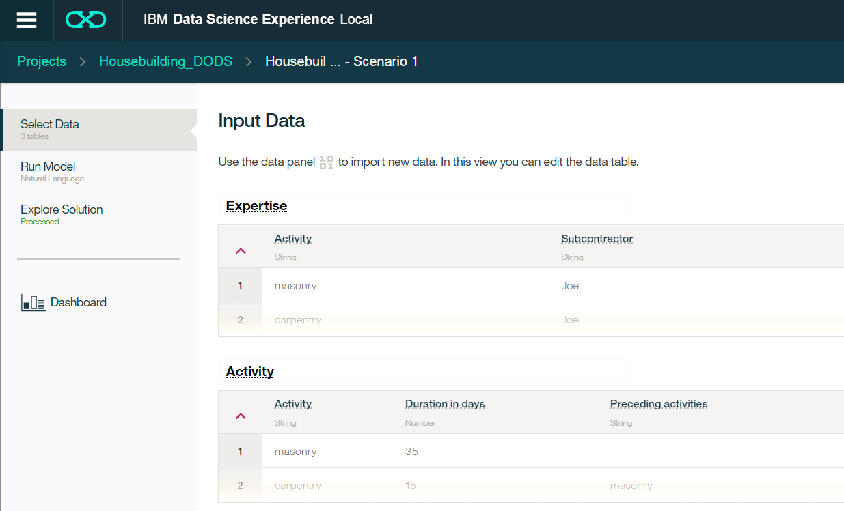
Using the DODS Add-on
Select data input & output
Manually create & import a mode or train one interactively
Basic charts and data widgets

Slide 19
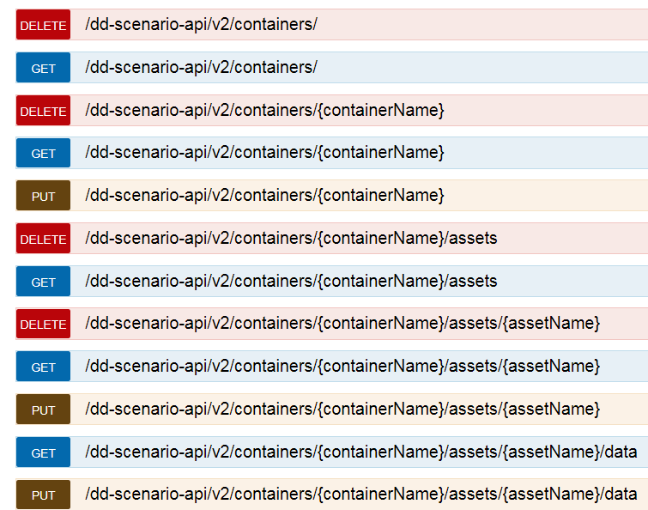
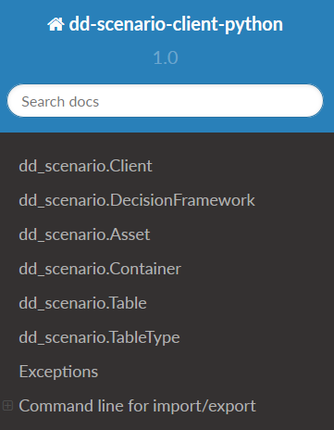
Using DODS Decision Framework API (BETA) in Jupyter Notebooks
Use and existing Scenario or create a new one
Useful for What-If analysis
Use the Python API in a Notebook or REST API

Slide 21


Using the Remote Execution Service (BETA)
Use the Decision Framework API
Community Projects → dsx-samples → DecisionOptimizationModelDeployment
Allows for publishing and executing a model.
DODS
Notebook/API
Create & Test Model
Create & Test Model
Generate URL & Token
Publish
URL
Execute
Token

Slide 22
Lab Work
https://github.com/jc900/FastStart_DDLabs
Follow instructions on the Readme
Lab 1 - Utilizing the DOCplex Python API from Notebooks
Lab 2 - Creating an Optimization Model & Planning scenarios with DODS
Lab 3 – Preview: Walk-through the Execution Service (BETA)

Slide 23
Where to Go to Learn More…
DSX Local - https://datascience.ibm.com/docs/content/local/welcome.html
DODS (git hub) – https://w3-connections.ibm.com/wikis/home?lang=en#!/wiki/Wf58c4c538dbf_45b4_b7a7_5003d0ceb79b/page/ZACS (navigate to Decision Optimization).

Slide 24
Thank you
John Chaves
Analytics Solutions Architect
—
john.chaves@us.ibm.com
+1-813-391-5407
ibm.com

Slide 25


Slide 26
Legal Disclaimer
© IBM Corporation 2018. All Rights Reserved.
The information contained in this publication is provided for informational purposes only. While efforts were made to verify the completeness and accuracy of the information contained in this publication, it is provided AS IS without warranty of any kind, express or implied. In addition, this information is based on IBM’s current product plans and strategy, which are subject to change by IBM without notice. IBM shall not be responsible for any damages arising out of the use of, or otherwise related to, this publication or any other materials. Nothing contained in this publication is intended to, nor shall have the effect of, creating any warranties or representations from IBM or its suppliers or licensors, or altering the terms and conditions of the applicable license agreement governing the use of IBM software.
References in this presentation to IBM products, programs, or services do not imply that they will be available in all countries in which IBM operates. Product release dates and/or capabilities referenced in this presentation may change at any time at IBM’s sole discretion based on market opportunities or other factors, and are not intended to be a commitment to future product or feature availability in any way. Nothing contained in these materials is intended to, nor shall have the effect of, stating or implying that any activities undertaken by you will result in any specific sales, revenue growth or other results.
Performance is based on measurements and projections using standard IBM benchmarks in a controlled environment. The actual throughput or performance that any user will experience will vary depending upon many factors, including considerations such as the amount of multiprogramming in the user's job stream, the I/O configuration, the storage configuration, and the workload processed. Therefore, no assurance can be given that an individual user will achieve results similar to those stated here.
All customer examples described are presented as illustrations of how those customers have used IBM products and the results they may have achieved. Actual environmental costs and performance characteristics may vary by customer.
All references to fictitious companies are used for illustration purposes only.

